Slide 1
Finlatics Data Science Case Project

Slide 2
Domain:
“Media and Technology”
Analysing Youtube content creators dataset

Slide 3
About the Case Project
A collection of YouTube giants, this dataset offers a perfect avenue to analyze and gain valuable insights from the luminaries of the platform.
With comprehensive details on top creators' subscriber counts, video views, upload frequency, country of origin, earnings, and more.
This treasure trove of information is a must-explore for aspiring content creators, data enthusiasts, and anyone intrigued by the ever-evolving online content landscape.
Immerse yourself in the world of YouTube success and unlock a wealth of knowledge with this extraordinary dataset.

Slide 4
About the Dataset
Key Features:
rank: Position of the YouTube channel based on the number of subscribers
Youtuber: Name of the YouTube channel
subscribers: Number of subscribers to the channel
video views: Total views across all videos on the channel
category: Category or niche of the channel
Title: Title of the YouTube channel
uploads: Total number of videos uploaded on the channel
Country: Country where the YouTube channel originates
Abbreviation: Abbreviation of the country
created_year: Year when the YouTube channel was created
created_month: Month when the YouTube channel was created
created_date: Exact date of the YouTube channel's creation
Gross tertiary education enrollment (%): Percentage of the population enrolled in tertiary education in the country
Population: Total population of the country
Unemployment rate: Unemployment rate in the country
Urban_population: Percentage of the population living in urban areas
Latitude: Latitude coordinate of the country's location
Longitude: Longitude coordinate of the country's location
channel_type: Type of the YouTube channel
video_views_rank: Ranking of the channel based on total video views
country_rank: Ranking of the channel based on the number of subscribers within its country
channel_type_rank: Ranking of the channel based on its type video_views_for_the_last_30_days: Total video views in the last 30 days
lowest_monthly_earnings: Lowest estimated monthly earnings from the channel
highest_monthly_earnings: Highest estimated monthly earnings from the channel
lowest_yearly_earnings: Lowest estimated yearly earnings from the channel
highest_yearly_earnings: Highest estimated yearly earnings from the channel
subscribers_for_last_30_days: Number of new subscribers gained in the last 30 days

Slide 5
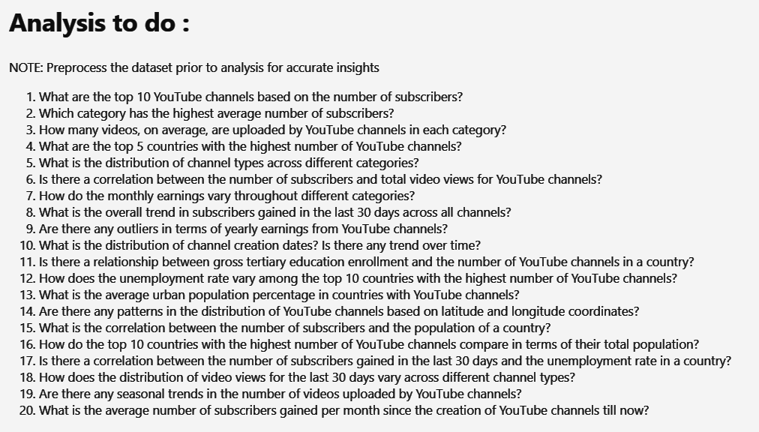

Slide 6
Data Preprocessing

Slide 7
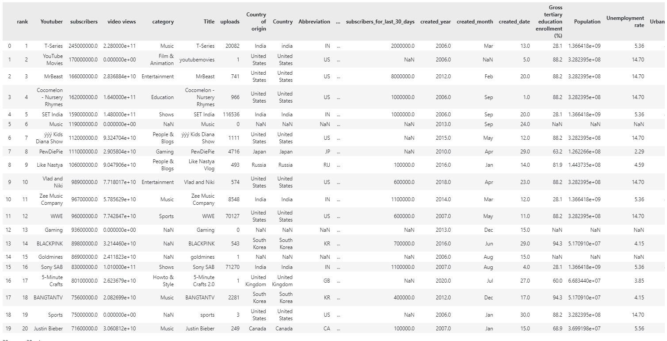
Dataset Before Preprocessing

Slide 8
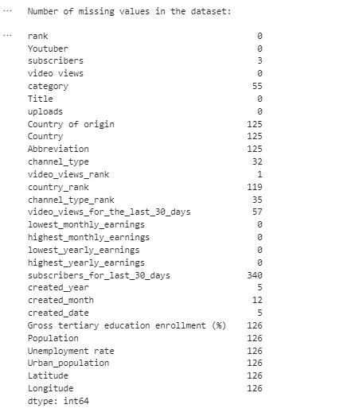
missing values in the Dataset

Slide 9
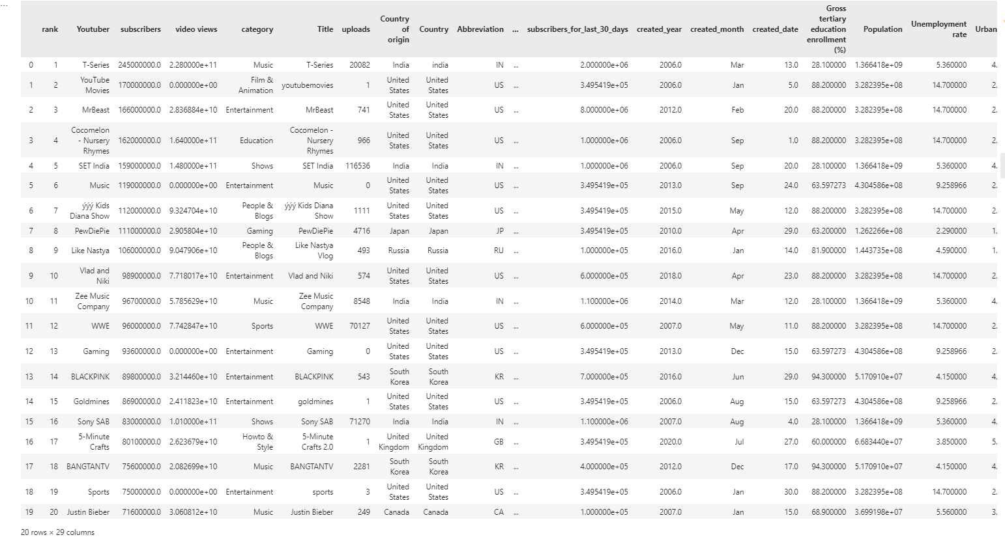
Dataset After Preprocessing

Slide 10
Insights

Slide 11
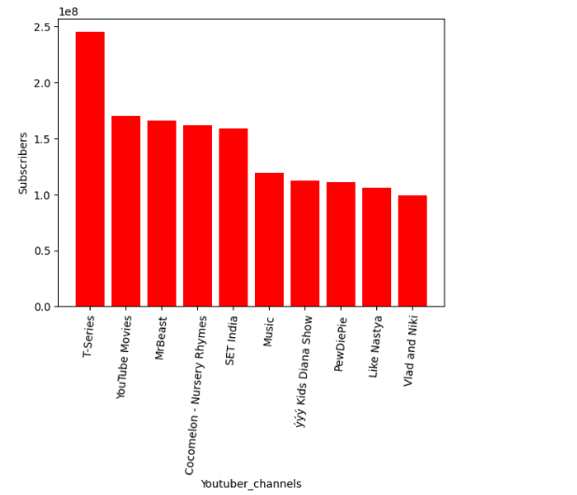
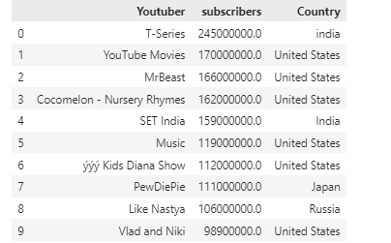
Top 10 Youtube Channels based on no. of Subscribers
T-series has the most no. of subscribers .

Slide 12
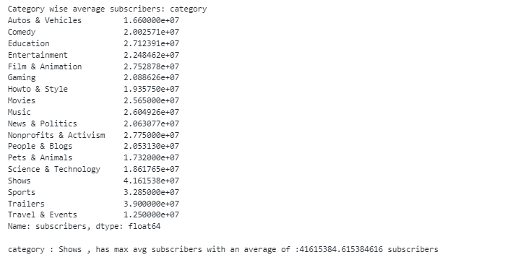
Category “shows” has the highest no. of subscribers across all the categories .

Slide 13
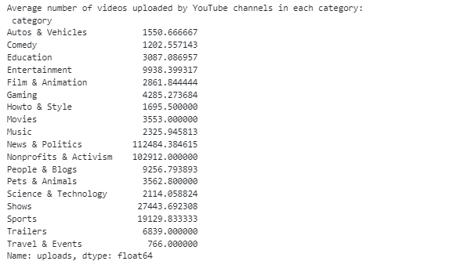
avg highest no. of videos uploaded belong to “News and Politics” category

Slide 14
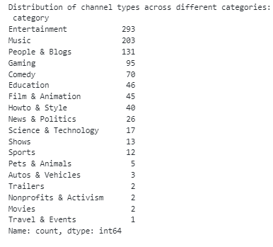
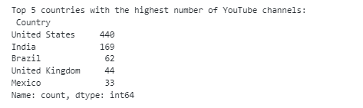
most of the Youtube channels make content for the “Entertainment” of people
US has the max no. of Youtube channels around the world
about 440

Slide 15
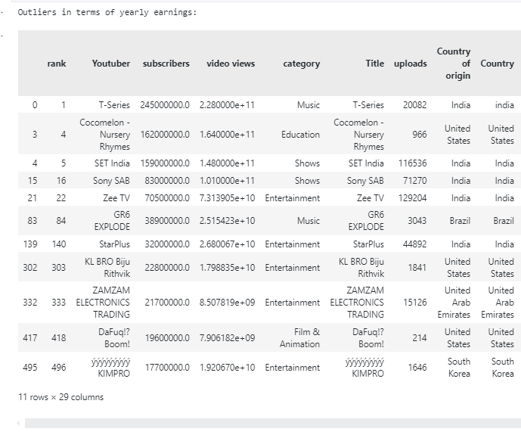
Around 11 Youtube channels behave as has very big deviation in yearly income

Slide 16
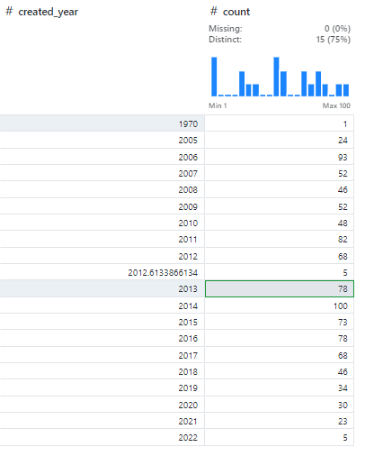
The Highest no. of Youtube channel were created in the Year “2014” - 100
while 2nd highest was year 2013 - 78

Slide 17
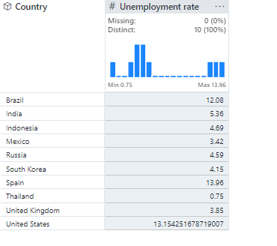
Correlation b/w the No. of subscribers and the total number of video views is approximately 74 % , i.e around 74 % of the subscribers watch the uploaded video content after subscribing.
The overall subscribers in the last 30 days across all channels is 351,639,103.
Around 77.5 % of the of the the population across the tertiary education enrollment use Youtube channels for education purposes.
T-series Channel has the highest no. of avg subscribers added per month since its creation date
Spain has the most unemployment rate of its total population approx 14 %
followed by
US around 13.15 %
Brazil around 12 %
India around 5.3 %

Slide 18
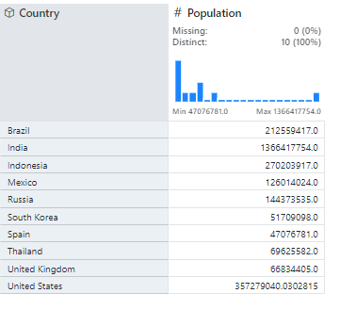
Population of top 10 Countries with highest no. of Youtube Channels:
India has the most population

Slide 19
Thank You

